Slide 1
Project overview

Slide 2
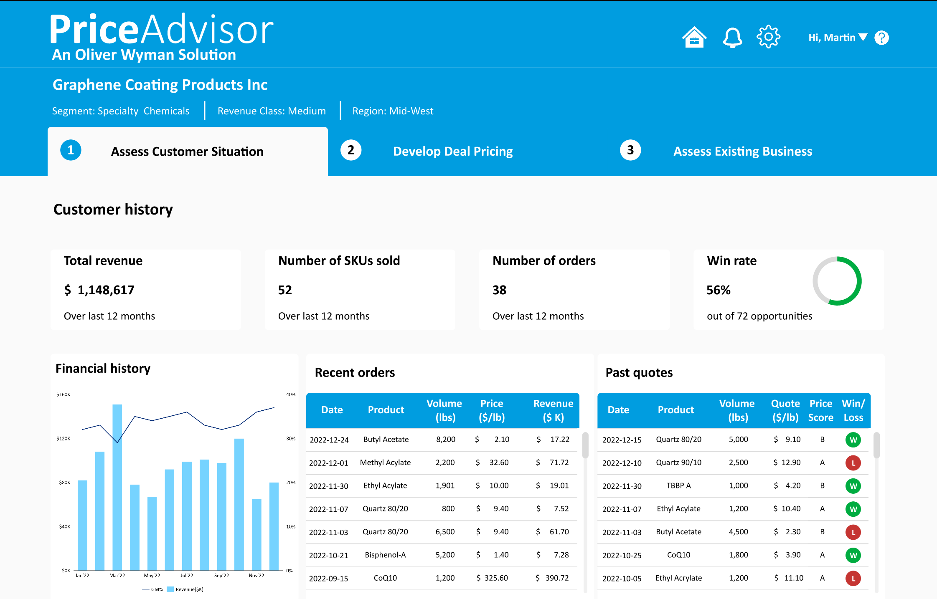
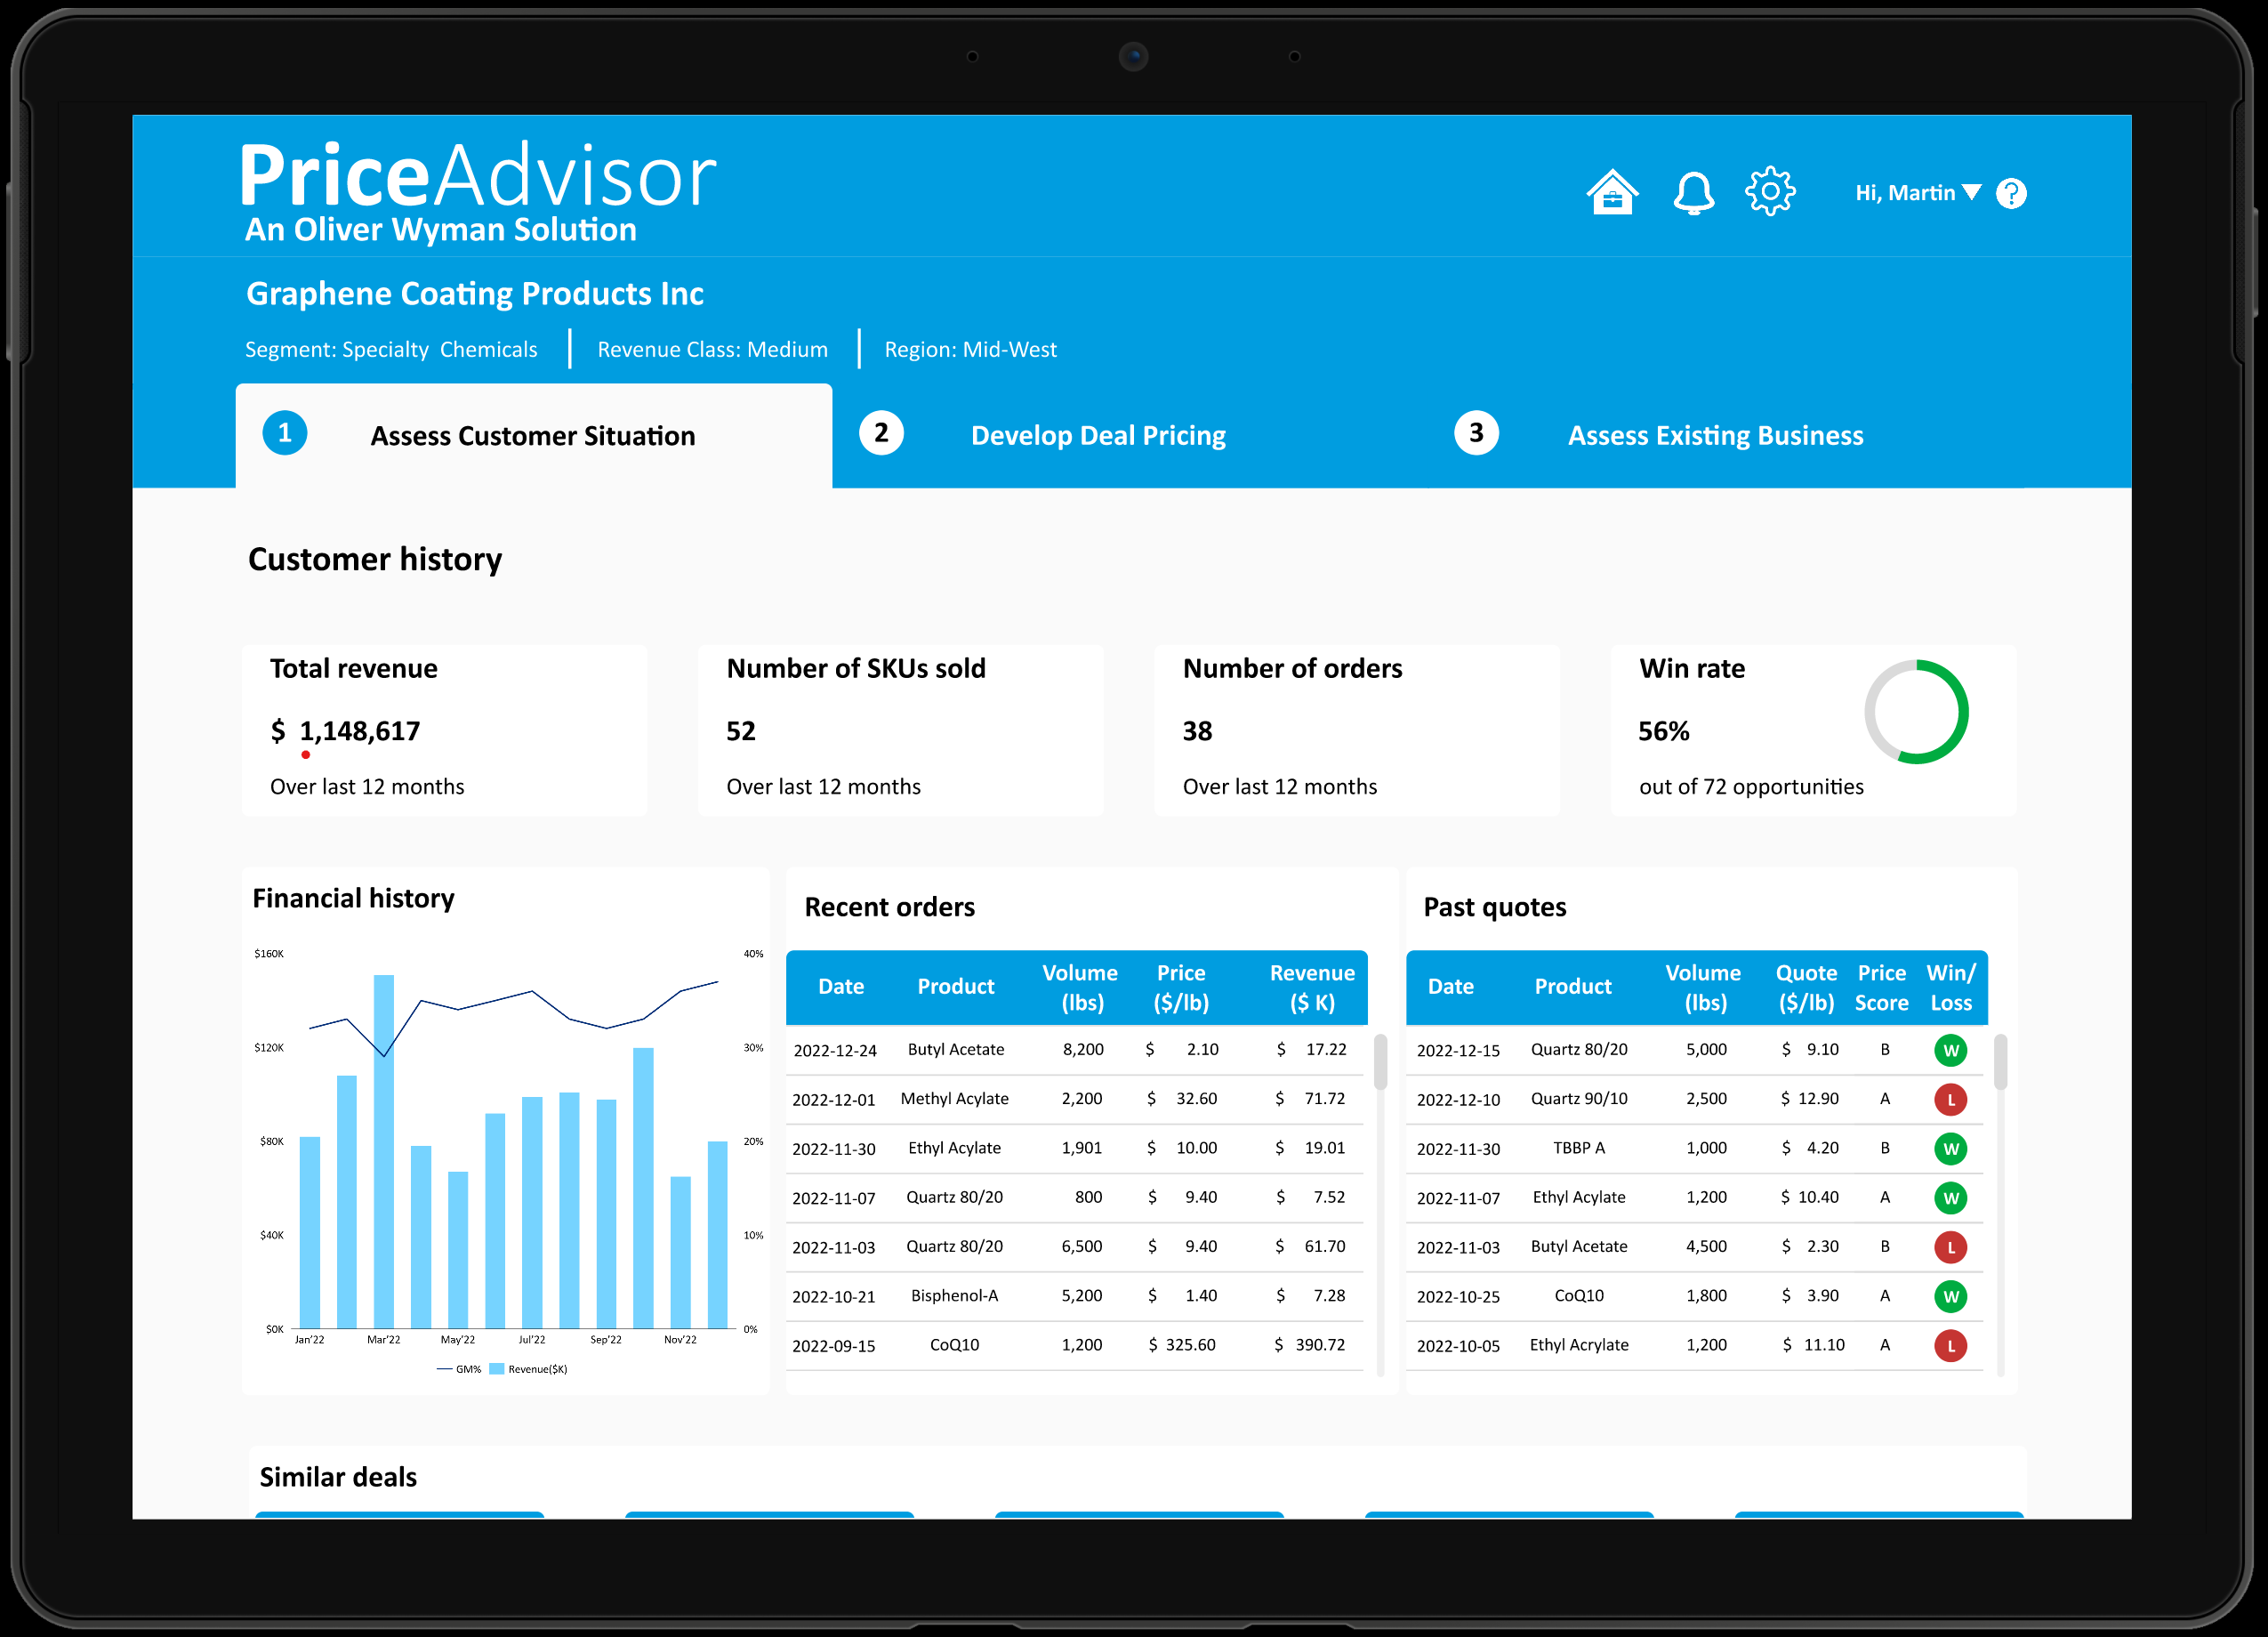
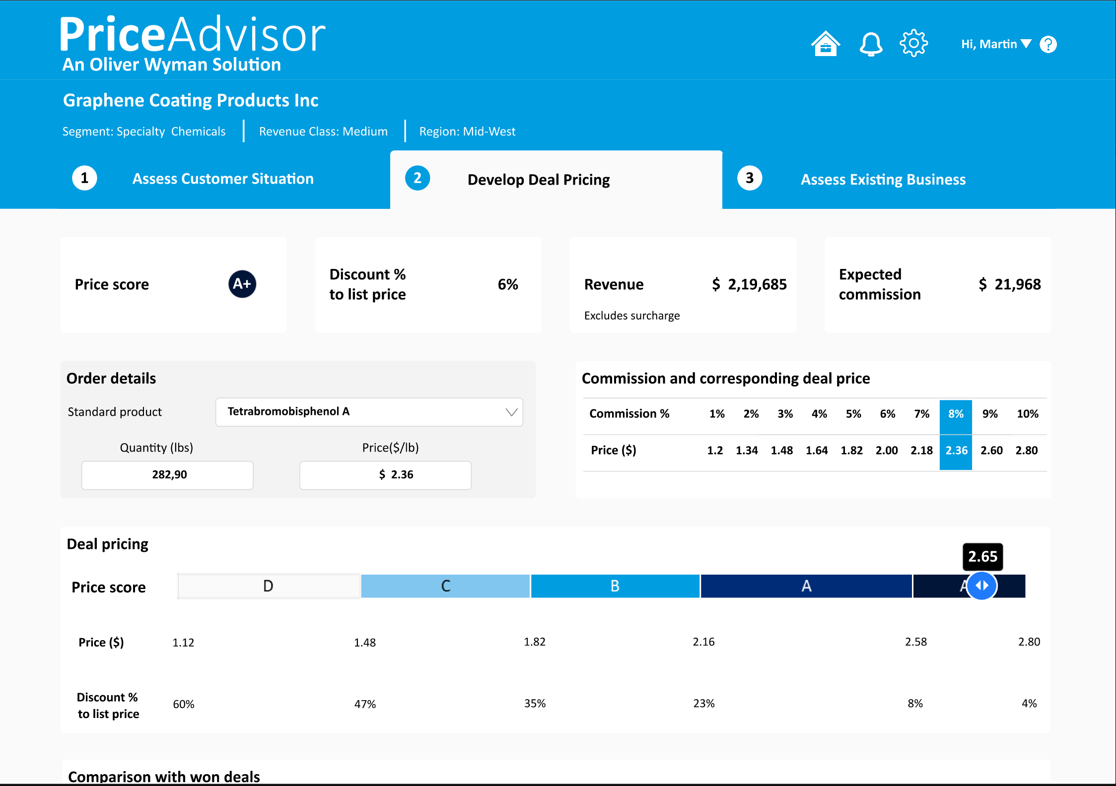
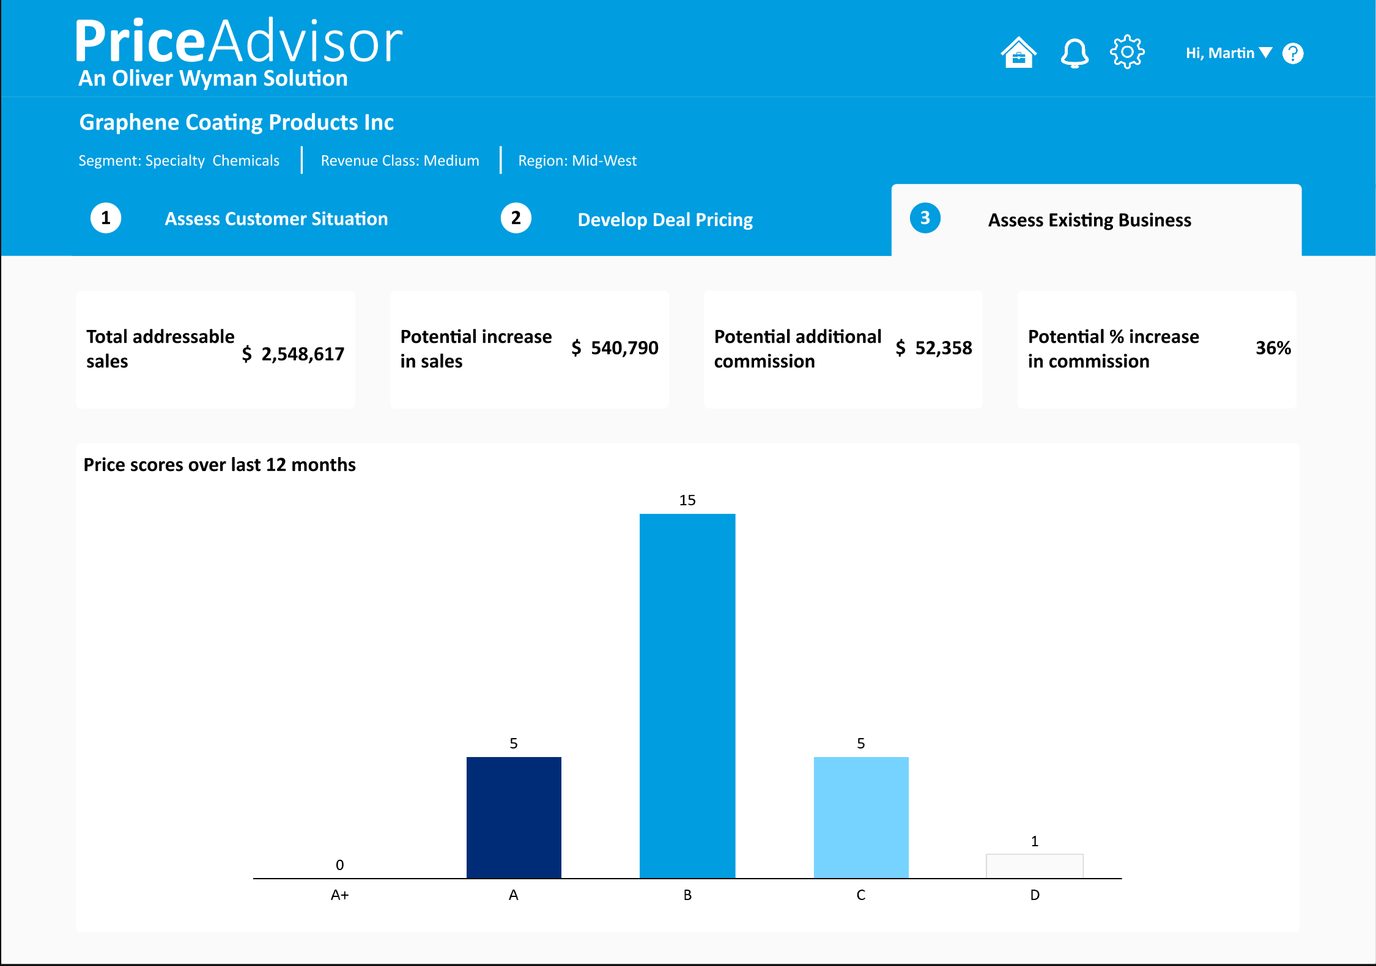
Overall vision & objectives Custom, easy-to-use pricing tool supports a structured quoting process
1A
Requirements for a pricing tool at DuBois
Based on input from commercial team
Illustrative pricing tool for DuBois
Based on Oliver Wyman PriceAdvisor for chemical industry clients
✓
Easy for user to navigate, input requirements, and create a quote
Anchors rep. on book and target pricing vs. material margins
Outlines expected commissions
Enables guardrails to control variability
Provides deal scoring
Tracks and provides data analytics on quote performances
Available on both mobile and PC (as screen in dynamics)
Integrates well with current data and systems environment
Shows the customers situation and price performance
✓
Mobile-friendly for Reps and Technicians to leverage in-field
✓
✓
✓
✓
Provides deal-specific guidance to increase margins and motivate value-selling
✓
✓
Scores the offer and benchmarks it against historical deals

Slide 3
Process Steps: future state overview among various use cases
No or limited change to current process
Change to current process & tool
Core initial pricing tool build
Enabled fast follower capability
2A
Legend
1. Discovery & qualification
2. Quoting process and approvals
3. Ordering & tracking
Process differs 1.1 to 1.4
1.5 Trials & Samples
2.1 Develop Quote
2.2 Approve Quote
2.3 Send quote to customer
2.4 Iterate Quote Drafts
2.5 Establish Price in F&O
3.1 Place order
3.2 Fulfill order
3.3 Bill to
cash
3.4 Track Win/loss
A. New customer
1.1 Customer setup request
1.2 Segment assignment
1.3 Locate Prior Terms
1.4 Create Opportunity
New customer created in CRM, assigned customer # in F&O, and confirm commercials (e.g., delivery term, ship-to locations) | Sales Ops confirms correct customer setup in F&O, assign customer segment and check for prior customer family | N/A | Create new opportunity in CRM. Enter high-level revenue and product line expectations tab
B. Existing customer, new product¹
1.1 Customer setup request
1.2 Segment assignment
1.3 Locate Prior Terms
1.4 Create Opportunity
N/A | N/A | Rep verifies that this is a new product without prior pricing terms | Create new opportunity in CRM. Enter customer ID and revenue and product line expectations tab. Customer details are pulled automatically
C. Existing customer, price update
1.1 Customer setup request
1.2 Segment assignment
1.3 Locate Prior Terms
1.4 Create Opportunity
N/A | N/A | Rep views current product terms (contract length, price / quantity, etc.) within PriceAdvisor as a reference point for desired update | Create new opportunity in CRM. Enter customer ID and revenue and product line expectations tab. Customer details are pulled automatically
D. Existing customer, product update
1.1 Customer setup request
1.2 Segment assignment
1.3 Locate Prior Terms
1.4 Create Opportunity
N/A | N/A | Rep views current product terms (contract length, price / quantity, etc.) within PriceAdvisor as a reference point for desired update | N/A
1. Includes new customer ship-to location under current customer family

Slide 4
CRM overview and opportunity/Quote form changes

Slide 5
Quoting happens in PriceAdvisor. PriceAdvisor writes the completed quote to the CRM Quote record. The CRM Quote is then routed for approval. The Opportunity only displays the Quote’s progress.
Opportunity is created in CRM
At this point, the opportunity is just the sales container; quoting doesn’t happen
Sales rep launches PriceAdvisor from the Opportunity
PriceAdvisor becomes the quoting workspace.
Quote is built in PriceAdvisor
Products, revenue, margin, price guidance, and deal score are calculated.
Leading PL1 is calculated from quote lines.
Approval level is calculated: Auto-approve / L1 / L2 / L3 / L4 / Auto-reject
Required approvers are identified using:
Sales Recap To table for Sales Manager / CBU Lead
PM table for Product Manager / Portfolio Director
Commercial / Enterprise queue setup for L3 / L4
PriceAdvisor writes the completed quote to CRM
Once the rep finishes, it writes the quote data back to Dynamics.
It creates or updates the separate CRM Quote record linked to the Opportunity.
CRM quote receives leading PL1, level of approval, quote approval status…
Quote submitted for approval and routed to queues
Quote approval status moves to the first required approval step
Quote is routed to the relevant queues as per approval process
CRM Quote object fields:
Quote approval status = current pending approval step
Current queue = queue receiving the work item
Current approver = person/team responsible
Approver acts on the CRM Quote
Approver opens the queued CRM Quote and takes action:
Approve or Reject
If more approval is needed:
Current queue item is completed
Next queue item is created
Quote approval status moves to the next approval step
If final approval is reached:
Quote approval status = Approved
Quote status = Approved
If rejected:
Quote approval status = Rejected
Quote returns to the sales rep / PriceAdvisor workflow as needed
Opportunity reflects the CRM Quote status
Business Process Flow stages are a visual representation of quote’s progress

Slide 6
Opportunity form and process changes (1/2)
Level-setting
PriceAdvisor entry point
Remove Opportunity product-entry
Area | Requirement
Opportunity purpose | The Opportunity will remain the sales container and visual progress record for the quote.
Quoting location | Users will not build or maintain quote products directly on the Opportunity. Quoting will occur in PriceAdvisor.
Quote system of record | Completed quote details will be written by PriceAdvisor to the CRM Quote record linked to the Opportunity.
Opportunity display | The Opportunity will display read-only quote summary information sourced from the linked CRM Quote record.
Area | Requirement
PriceAdvisor launch | The existing embedded PriceAdvisor entrypoint will remain on the Opportunity.
User action | Sales reps will launch PriceAdvisor from the Opportunity to build or revise a quote.
Data handoff | The Opportunity ID will be passed to PriceAdvisor so that the completed quote can be written back to the correct CRM Opportunity / Quote relationship.
Section | Required Change
Product Lines | Delete from Opportunity Summary tab
Chemicals Products | Delete from Opportunity Summary tab
Equipment Products | Delete from Opportunity Summary tab
DONE
DONE
DONE
DONE
To DO
DONE

Slide 7
Opportunity form and process changes (1/2)
Add a “Quote Summary” Section
Add a “Product Line Summary” section
Assignment section changes
Remove non-required sections
Add section titled “Quote Summary” in Summary tab
All fields will be read-only on the Opportunity
Values will be sourced from the CRM Quote record
Fields to display in table format:
Deal Score
Average Discount % to Book Prices
Total Quote Revenue
Estimated Annual Revenue
Contribution Margin
Approval Level Required
Leading PL1
Add section “Product Line Summary” in Summary tab
All fields will be read-only on the Opportunity
Displayed as a table, with each row = item quoted
Values will be sourced from the CRM Quote record
Fields to display:
Item Name
Order Quantity
Price per Container
Price per lb
Discount % to Book
Revenue
Keep the Assignment section, but with additional fields (roles)
Assignment fields are read-only once populated by routing logic. All fields will be populated, regardless of level required
Values will be sourced from the CRM quote record
Fields to include:
L1: Sales Direct Manager
L1: Product Manager
L2: CBU Lead
L2: CBU Portfolio director
L3: Commercial / VP
L4: Enterprise Approval
Delete the “Revenue” and “Competitors” section
WIP
To DO
To DO
DONE

Slide 8
ApprovalS overview

Slide 9
Approvals workflow || crm implementation
PERSONAL QUEUES
Sales Dimension → personal queues
PriceAdvisor loads user context; lookups Sales Manager and CBU Lead from the “Sales Recap To” table in F&O
CRM flow routes the opportunity / quote to the personal queues based on level of approval required
Sales Rep context → Sales Manager (L1, L2, L3)
Sales Rep context → CBU lead (L2, L3, L4)
CUSTOM QUEUE
Product Dimension → create a PL1 x L1 and PL1 x L2 queue
PriceAdvisor calculates the leading PL1; lookups Product Manager and Portfolio Director from PM table in Dataverse
Need to create the PL1 x L1 and PL1 x L2 queues and implement the business process flow to route to the relevant queues
Leading PL1 by revenue → Product Manager (L1, L2, L3)
Leading PL1 by revenue → Portfolio Director (L2, L3, L4)
Commercial and Enterprise Approval
Custom queues are created for L3 and L4
Eric Cecilio and Jorge Alfaro (L3 - Commercial Approval)
Ken Chrisman and Chris Heinold (L4 - Enterprise Approval)

Slide 10
Approval workflows: Deal scores and size will drive routing of approvals
Operating Model and Organization
Complications with baskets still requiring definition:
Approval may imply multiple PL managers
Basket may involve multiple CBUs
Final approver matrix
Approval levels and role
L0*
Level | Approver | Objective of review
L0 | Auto-approved | Ensure speedy approvals of deals that clearly align with DuBois’ strategy and target prices *Flag if rated P for management awareness
L1 | Frontline Sales Manager + Product Line Manager | Review deals up to $250k with B scores. Understand pricing rationale and advise Sales Reps
L2 | CBU Product Director (Max) | Ensure strategic alignment of pricing of C and D scores up to $250k
L3 | Vice president of product/pricing (Eric OR Jorge) | Review margin and strategic alignment of deals with significant discount relative to target price. Review any deal below floor.
L4 | Chief revenue officer or CFO (Ken OR Chris) | Evaluate pricing for most important deals in context of business goals
P
L0
A
CD + TS
L1
L4
L3
B
Deal Score
C
L2
D
Auto-Block
E
L3
Note: “Or” implies review would be directed to both Ken/Chris as a means to split review burden (group to confirm whether either can provide review / sign-off)
0
$10k
100k
$250k
Deal Size
Note: Colors indicate the final approver for an opportunity; preceding levels will also need to approve. For example, L4 final approval will require L1-L3 approvals

Slide 11
Level of approval: Deal scores and size will drive level of approval required
3
Approval levels and role
UX perspectives
Level | Stage Name | Approver(s) | Approver is determined by…
L0 | N/A | Auto-approved (skips straight to close) | N/A
L1/L2 | Sales Manager Approval | Frontline Sales Manager [if L1-3] + CBU Lead (Eric J.) [if L2-4] | Sales-Rep driven (direct manager + CBU Commercial lead)
L1/L2 | Product Approval | Product Line Manager [if L1-3] + CBU Portfolio Director (Max) [if L2-4] | Product basket drives PL Manager + CBU Portfolio Director (highest PL1 by revenue of a basket, even if other CBU items are in the basket)
L3 | VP Approval | Vice president of product/pricing (Eric C. OR Jorge)¹ | Always Eric & Jorge
L4 | Enterprise Approval | Chief revenue officer or CFO (Ken OR Chris)¹ | Always Ken & Chris
L1 approvals have a sales and product line manager
The sales manager will be driven by direct manager of quote-requesting sales rep
The PL manager will be driven by the highest PL1 by revenue of a basket (even if other CBU items are in the basket)
Approvals are cumulative (e.g., L3 approval requirement means L1 and L2 need to approve first)
L3 and L4 approvals are sent to both listed approver parties and either may approve (quote is then removed from queue of other party)
Tool allows approvers to leave notes that cascade to each new approval (whether approval is rejected and accepted)
“Rejected” approvals require re-quoting (i.e., sent directly back to rep)
Pricing team is responsible for maintaining approval matrices
Tool considers only the products currently being quoted for approval, not existing customer basket
Final approvals are submitted to customer and require win/loss tracking
Note: Front-end tool determines the level of approval required. In many cases, the “stage” can be skipped (if that level of approval is not needed)
1. Note: “Or” implies review would be directed to both Ken/Chris as a means to split review burden (group to confirm whether either can provide review / sign-off)

Slide 12
Deep dive on l1-l4

Slide 13
Process flow (if L1 is required): L1 only
3
(Skipped)
(Skipped)
Queue | Field | Sales Manager Approval | Product Approval | Commercial Approval | Enterprise Approval
Core Approver | Approver | L1 - Sales Rep Direct Manager | L1 - Product Manager – “PM” (e.g., Shoshana for Lubricants) | L3 – VP Portfolio Management (Eric Cecilio) OR VP Commercial Excellence (Jorge) | L4 – Chief Revenue Officer (Ken Chrisman) or Chief Financial Officer (Chris Heinold)
 | Data | Map of Sales Reps and Direct Managers (exists within CRM) | Map of PL1s with PMs
 | Process Steps | Find sales rep manager Assign approval to queue If manager approves, move to next stage | Determine leading PL1 based on the products in basket Find PM based on PL1 Assign approval to queue If approver approves, send approval notice to Sales Rep
Secondary Approver | Approver | L2 – CBU Lead (Industrial: Eric Johnson) | L2 – CBU Portfolio Director (e.g., Max George for Industrial)
 | Data | Map of CBU Leads (exists within CRM / linked to managers) | Map of Portfolio Directors by CBU
 | Process Steps | N/A | N/A
If at any stage, quote is rejected, send notice to Sales Rep and reset approval queues
Case 1: Frontline Sales and PM

Slide 14
Process flow (if L2 is required): L1, L2
3
(Skipped)
(Skipped)
Queue | Field | Sales Manager Approval | Product Approval | Commercial Approval | Enterprise Approval
Core Approver | Approver | L1 - Sales Rep Direct Manager | L1 - Product Manager – “PM” (e.g., Shoshana for Lubricants) | L3 – VP Portfolio Management (Eric Cecilio) OR VP Commercial Excellence (Jorge) | L4 – Chief Revenue Officer (Ken Chrisman) or Chief Financial Officer (Chris Heinold)
 | Data | Map of Sales Reps and Direct Managers (exists within CRM) | Map of PL1s with PMs | N/A | N/A
 | Process Steps | Find sales rep manager Assign approval to queue If approved, move onto CBU Lead | Determine leading PL1 based on the products in basket Find PM based on PL1 Assign approval to queue If approved, move onto CBU Portfolio Director
Secondary Approver | Approver | L2 – CBU Lead (Industrial: Eric Johnson) | L2 – CBU Portfolio Director (e.g., Max George for Industrial)
 | Data | Map of CBU Leads (exists within CRM / linked to managers) | Map of Portfolio Directors by CBU
 | Process Steps | Find CBU Lead manager Assign approval to queue | Determine CBU Product Director based on leading PL1 Assign approval to queue
 |  | Steps above commence sequentially If both manager approve, move to next stage | Steps above commence sequentially If both parties approve, send approval notice to Sales Rep to share quote with Customer
If at any stage, quote is rejected, send notice to Sales Rep and reset approval queues
Note: L1 and L2 Product Approvals may be mapped to the same approver (in which case there should only be 1 approval required at this stage)
Case 2: L1 + CBU Lead and Portfolio Director

Slide 15
Process flow (if L3 is required): L1, l2, L3
3
(Skipped)
Queue | Field | Sales Manager Approval | Product Approval | Commercial Approval | Enterprise Approval
Core Approver | Approver | L1 - Sales Rep Direct Manager | L1 - Product Manager – “PM” (e.g., Shoshana for Lubricants) | L3 – VP Portfolio Management (Eric Cecilio) OR VP Commercial Excellence (Jorge) | L4 – Chief Revenue Officer (Ken Chrisman) or Chief Financial Officer (Chris Heinold)
 | Data | Map of Sales Reps and Direct Managers (exists within CRM) | Map of PL1s with PMs | N/A | N/A
 | Process Steps | Find sales rep manager Assign approval to queue If approved, move onto CBU Lead | Determine leading PL1 based on the products in basket Find PM based on PL1 Assign approval to queue If approved, move onto CBU Portfolio Director | Assign approval to both queues If EITHER approver approves, send approval notice to Sales Rep to share quote with Customer
Secondary Approver | Approver | L2 – CBU Lead (Industrial: Eric Johnson) | L2 – CBU Portfolio Director (e.g., Max George for Industrial)
 | Data | Map of CBU Leads (exists within CRM / linked to managers) | Map of Portfolio Directors by CBU
 | Process Steps | Find CBU Lead manager Assign approval to queue | Determine CBU Product Director based on leading PL1 Assign approval to queue
 |  | Steps above commence sequentially If both manager approve, move to next stage | Steps above commence sequentially If both parties approve, send approval notice to Sales Rep to share quote with Customer
If at any stage, quote is rejected, send notice to Sales Rep and reset approval queues
Case 3: L2 + Commercial Approval
2026-05-07 15:31 (-4) DC: There are a lot of reviewers in this scenario. Should Max and/or Eric Johnson be skipped here?

Slide 16
Process flow (if L4 is required): L2, L3, L4
3
Queue | Field | Sales Manager Approval | Product Approval | Commercial Approval | Enterprise Approval
Core Approver | Approver | L1 - Sales Rep Direct Manager | L1 - Product Manager – “PM” (e.g., Shoshana for Lubricants) | L3 – VP Portfolio Management (Eric Cecilio) OR VP Commercial Excellence (Jorge) | L4 – Chief Revenue Officer (Ken Chrisman) or Chief Financial Officer (Chris Heinold)
 | Data | Map of Sales Reps and Direct Managers (exists within CRM) | Map of PL1s with PMs | N/A | N/A
 | Process Steps |  |  | Assign approval to both queues If EITHER approver approves, move to next stage | Assign approval to both queues If EITHER approver approves, send approval notice to Sales Rep to share quote with Customer
Secondary Approver | Approver | L2 – CBU Lead (Industrial: Eric Johnson) | L2 – CBU Portfolio Director (e.g., Max George for Industrial)
 | Data | Map of CBU Leads (exists within CRM / linked to managers) | Map of Portfolio Directors by CBU
 | Process Steps | Find CBU Lead manager Assign approval to queue If manager approves, move to next stage | Determine CBU Product Director based on leading PL1 Assign approval to queue If manager approves, move to next stage
If at any stage, quote is rejected, send notice to Sales Rep and reset approval queues
Case 4: Part of L2 + Commercial Approval + Enterprise Approval

